Slide 1
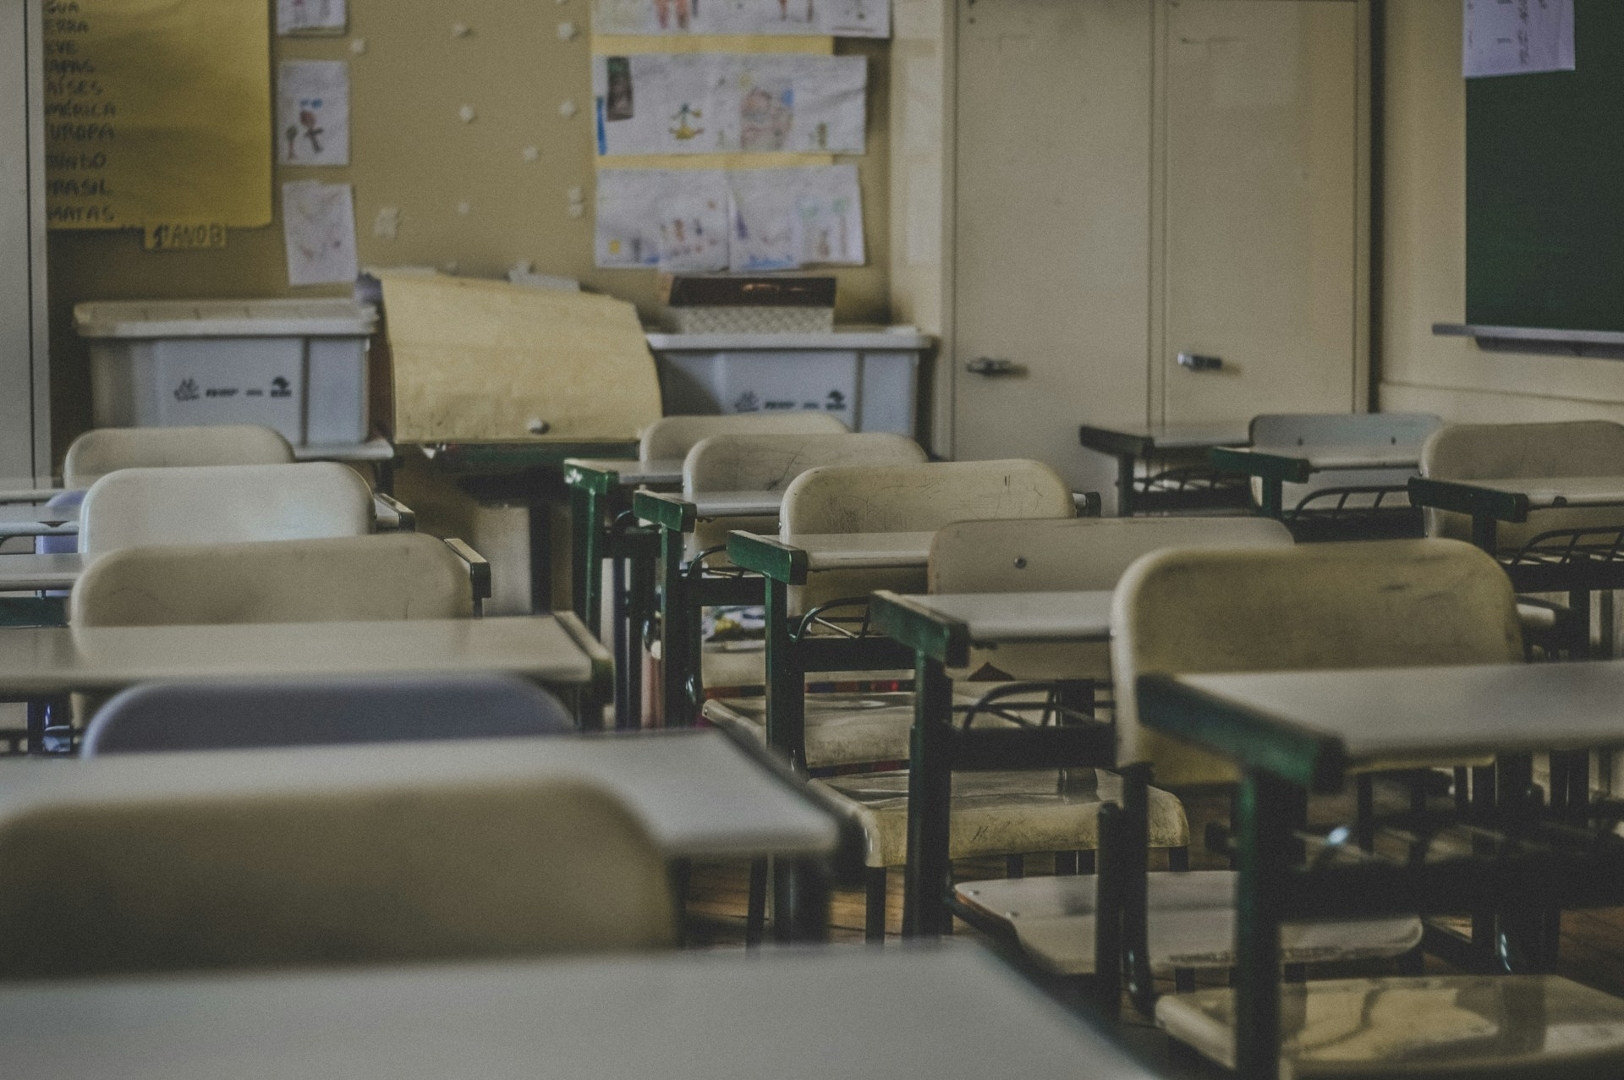
校園故事
nizima Live
Notes:
https://unsplash.com/photos/photography-of-school-room-hes6nUC1MVc?utm_content=creditShareLink&utm_medium=referral&utm_source=unsplash

Slide 2
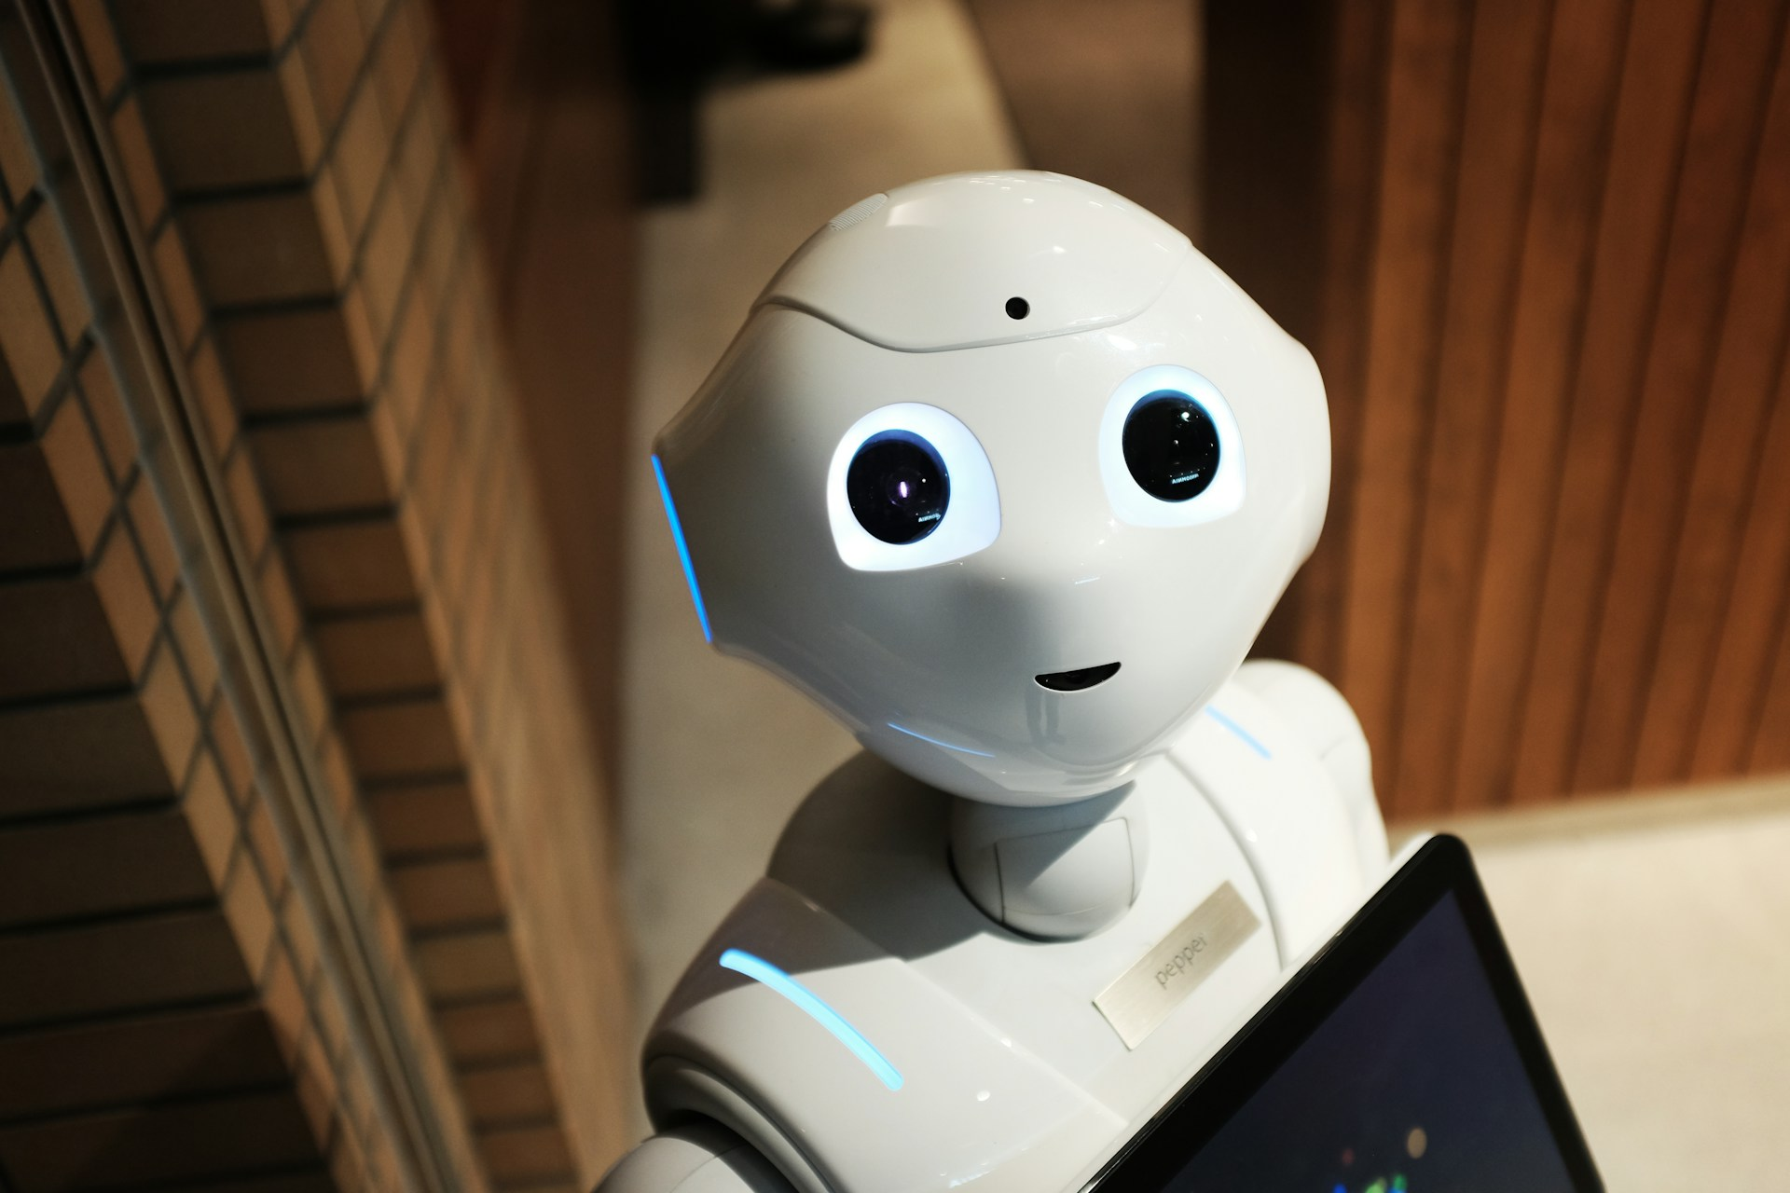
目標
Notes:
https://unsplash.com/photos/white-robot-near-brown-wall-2EJCSULRwC8

Slide 3
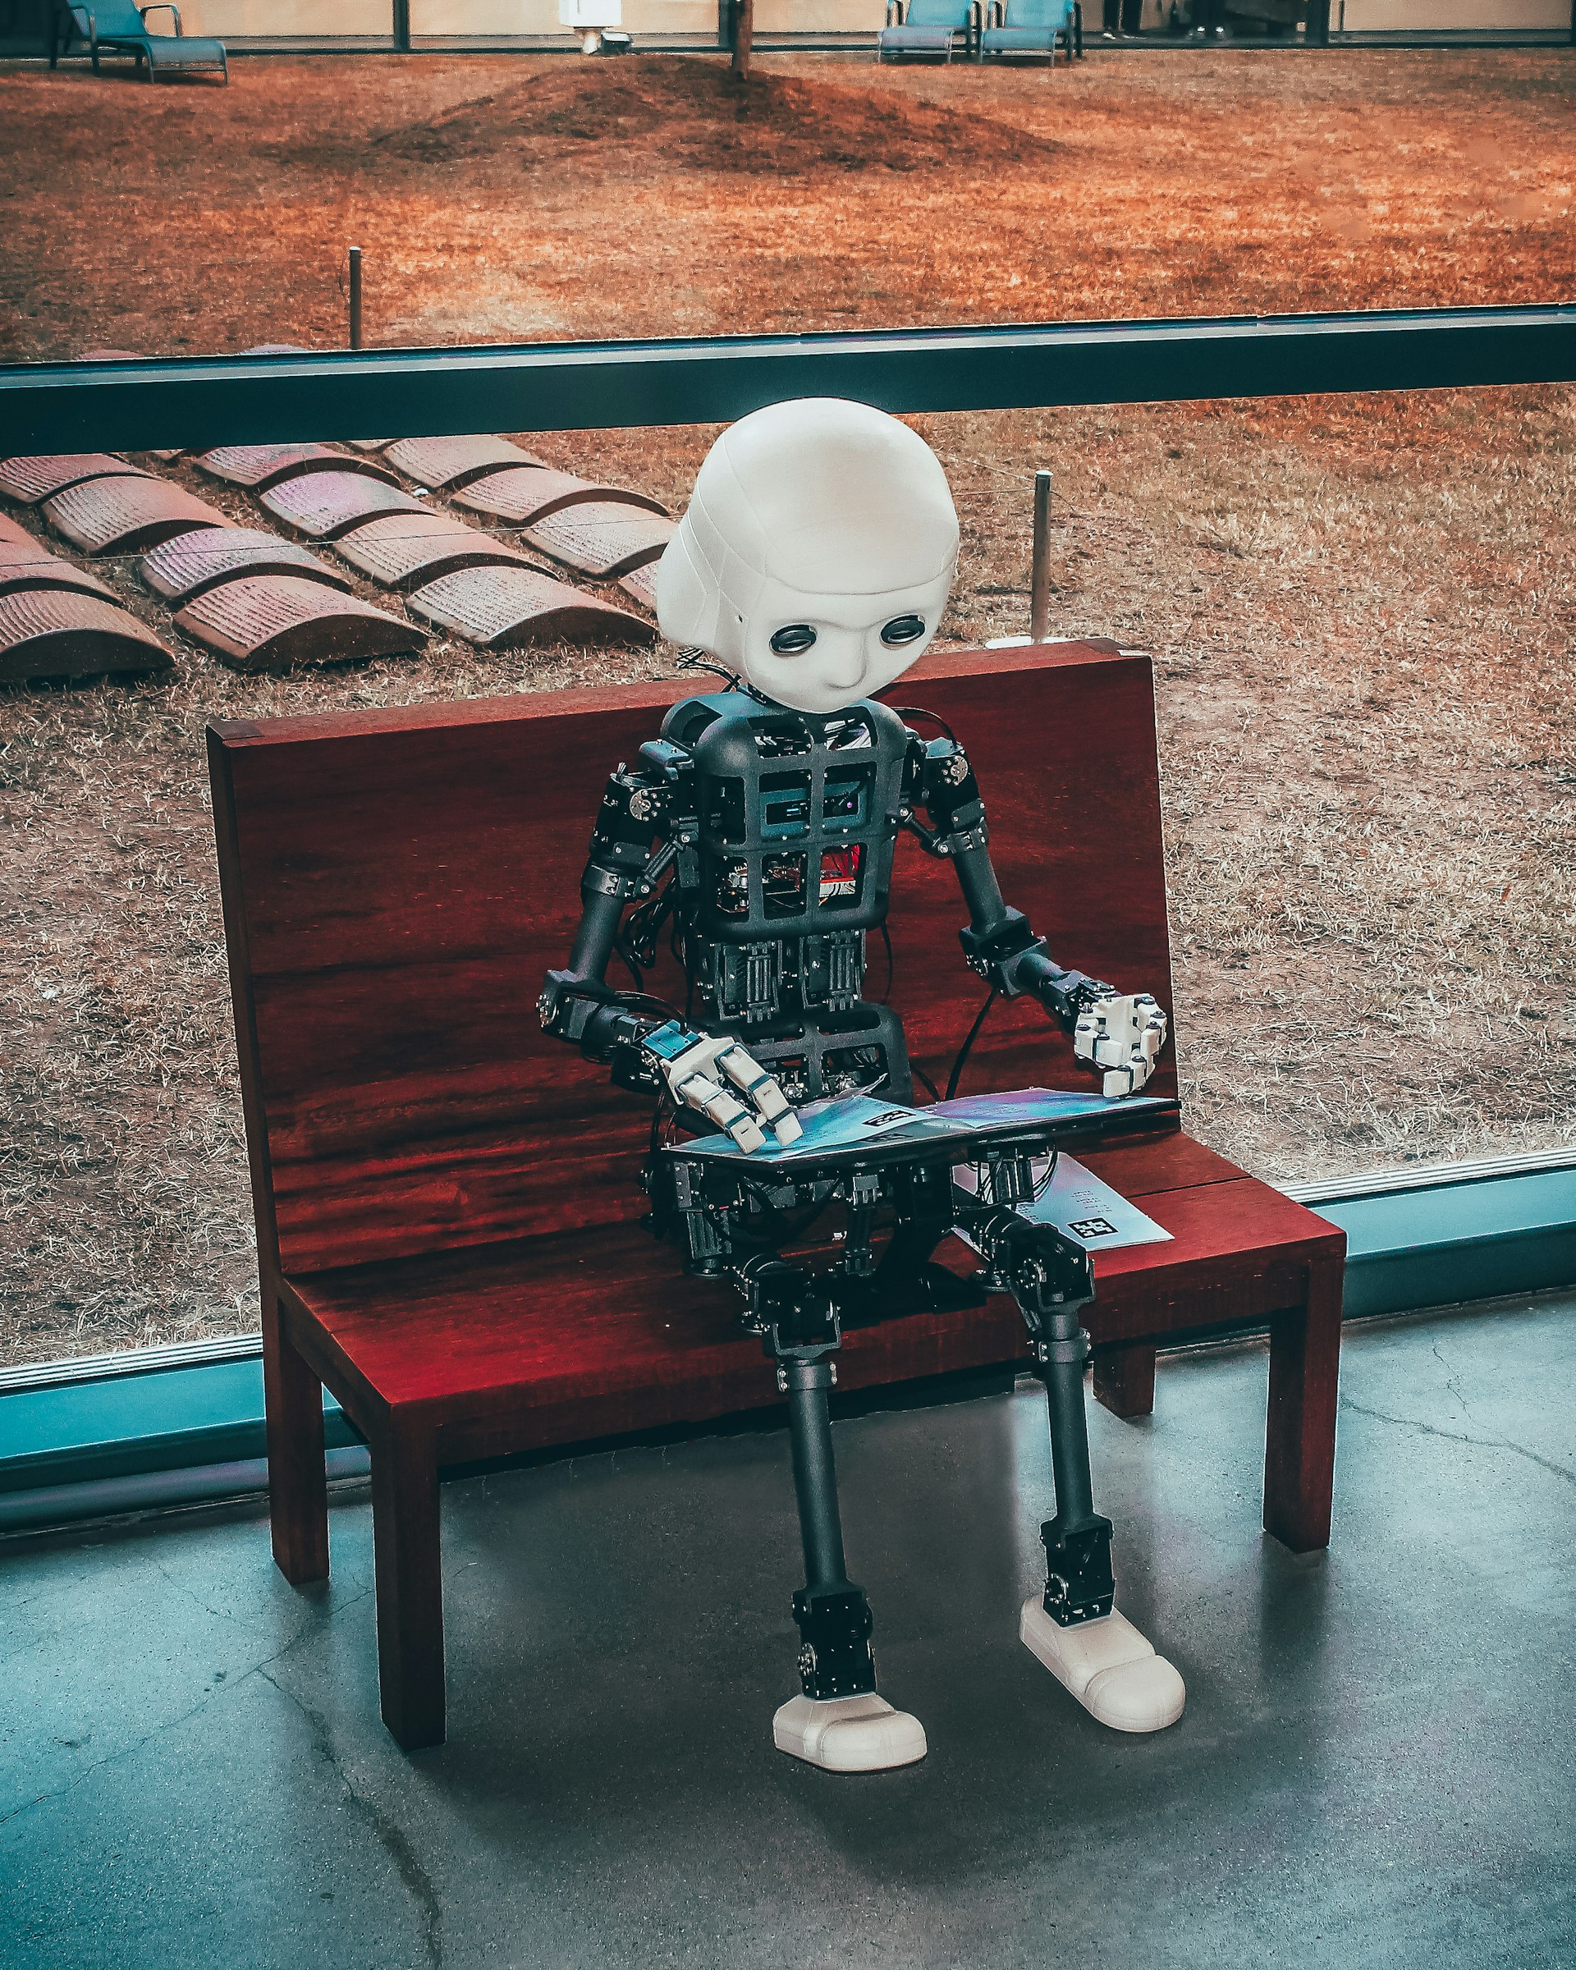
Notes:
https://unsplash.com/photos/black-and-white-robot-toy-on-red-wooden-table-zwd435-ewb4

Slide 4

阻礙
Notes:
https://unsplash.com/photos/man-holding-his-chin-facing-laptop-computer-xj8qrWvuOEs

Slide 5
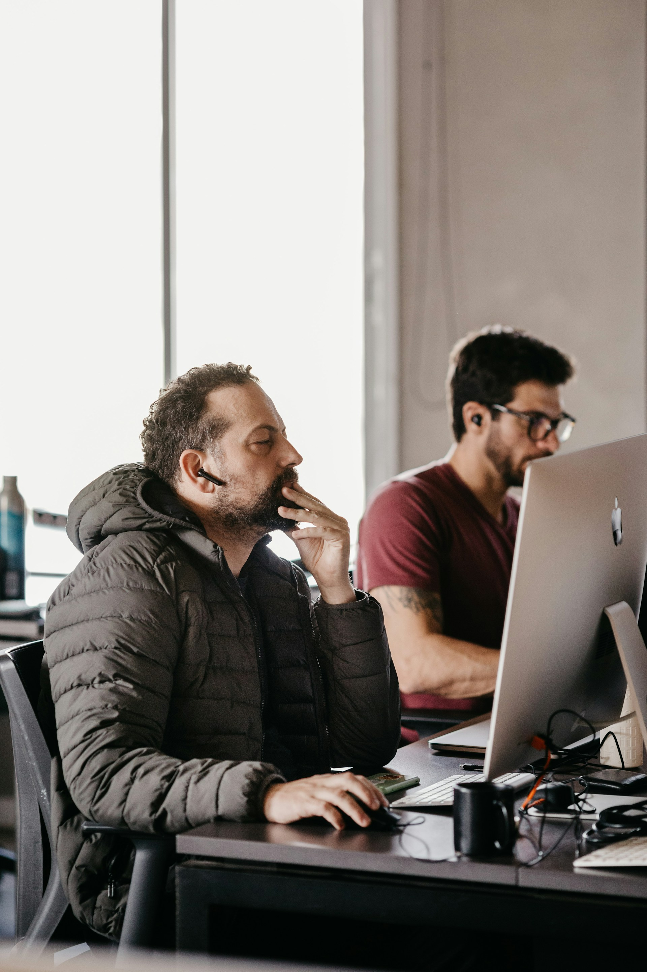
Notes:
https://unsplash.com/photos/men-sitting-at-a-desk-looking-at-a-computer-screen-K-yFktTaiZo

Slide 6
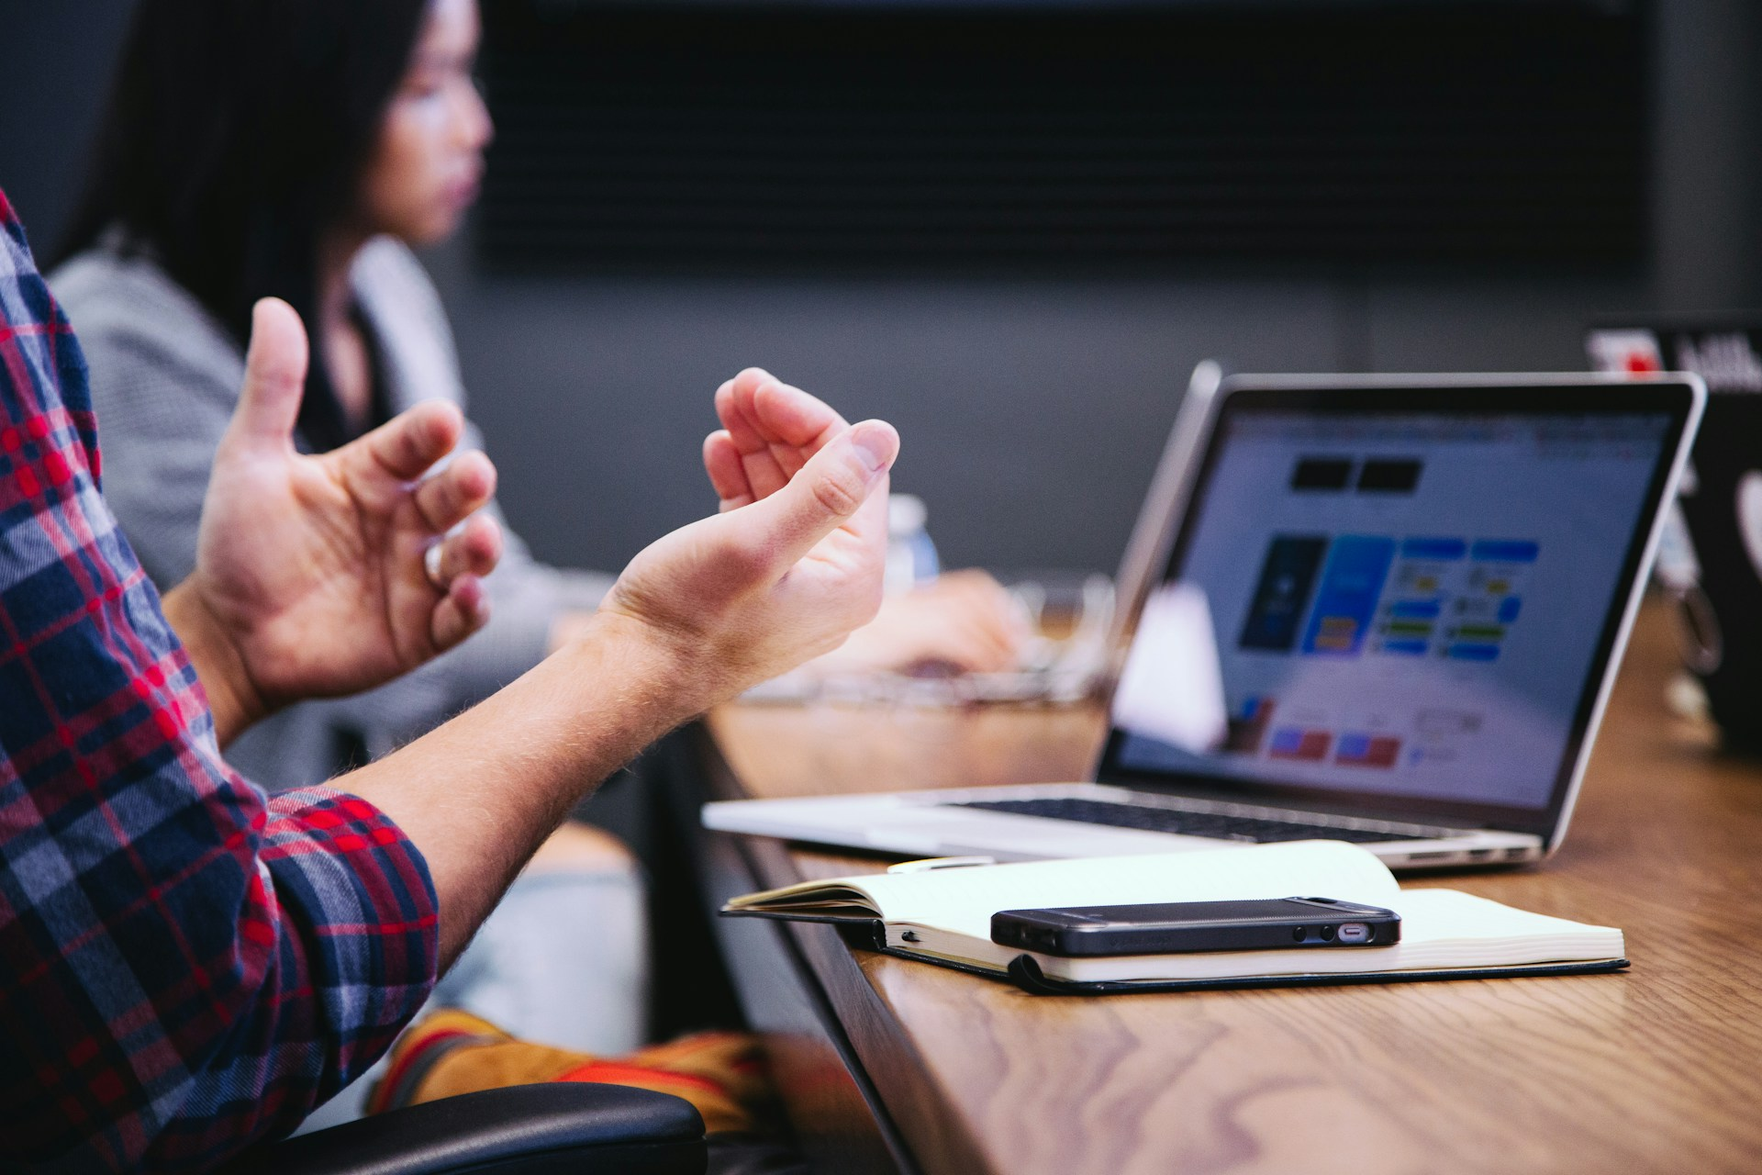
努力
Notes:
https://unsplash.com/photos/black-smartphone-near-person-5QgIuuBxKwM

Slide 7
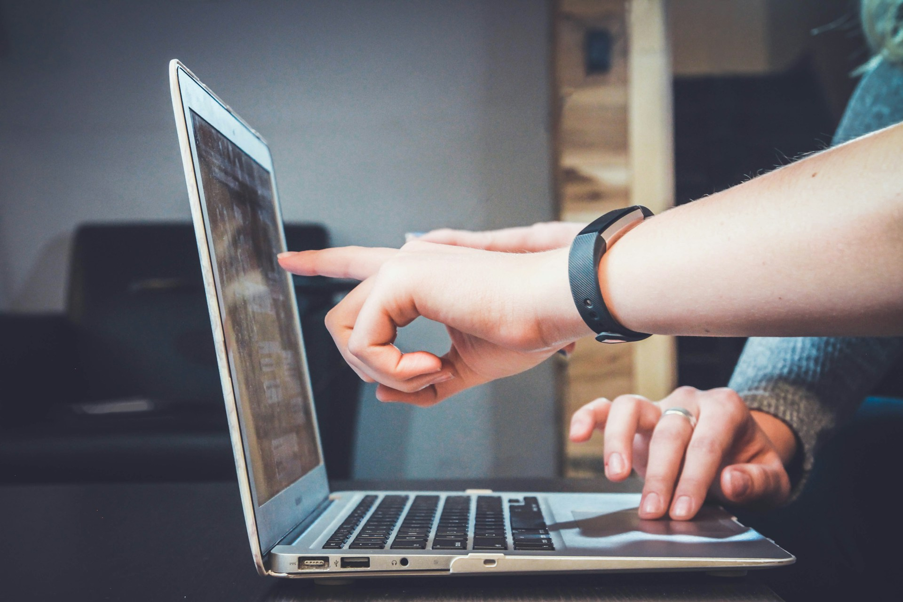
Notes:
https://unsplash.com/photos/person-using-laptop-FlPc9_VocJ4

Slide 8
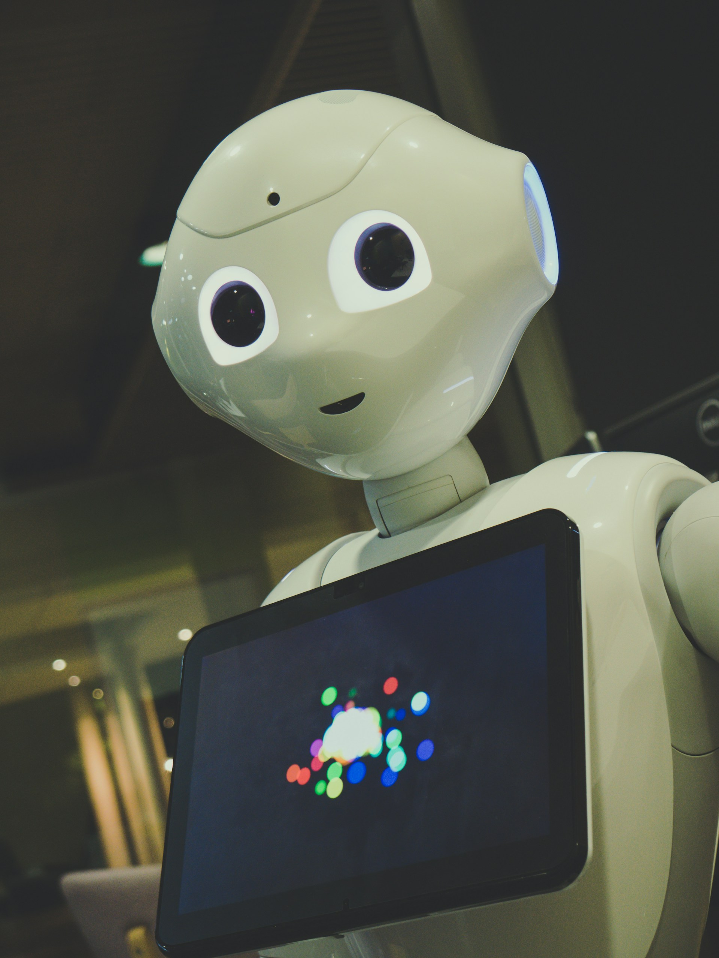
結果
Notes:
https://unsplash.com/photos/white-robot-toy-holding-black-tablet-K21Dn4OVxNw

Slide 9
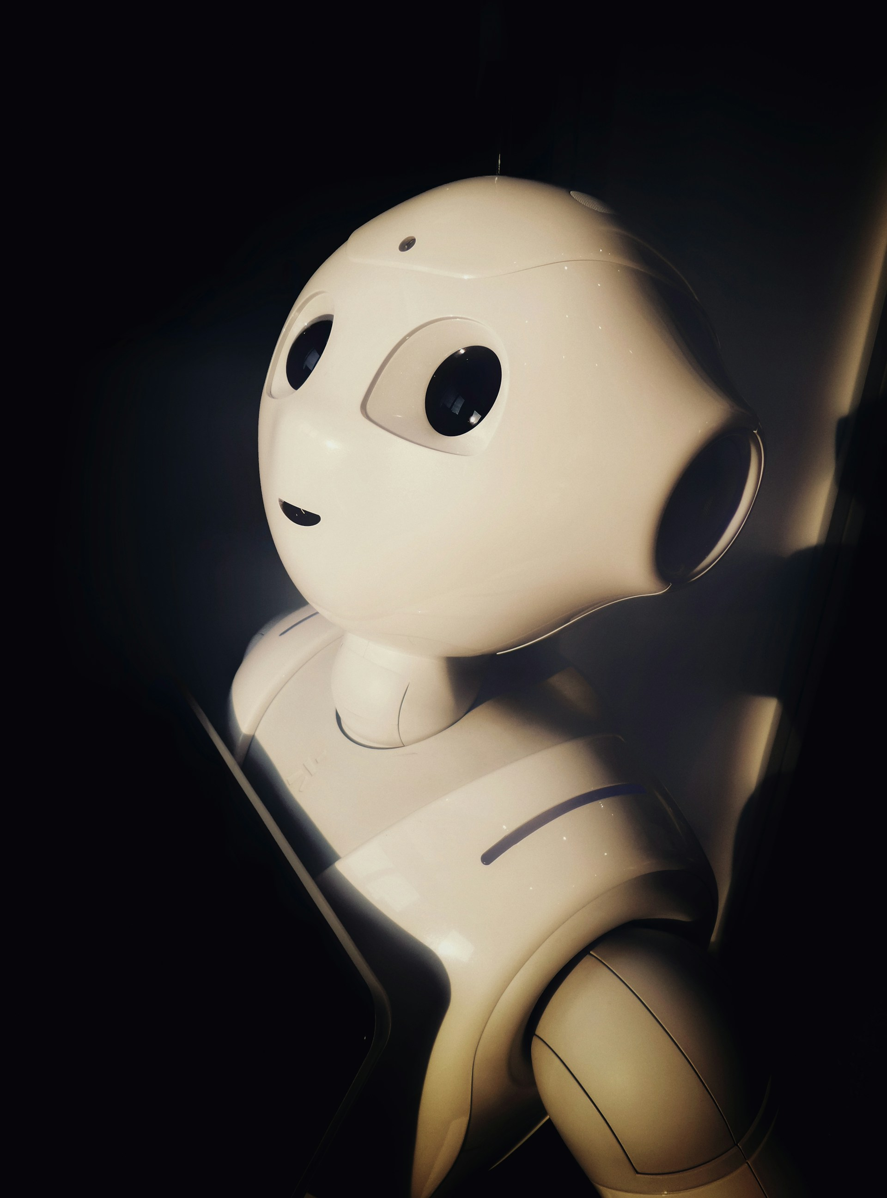
Notes:
https://unsplash.com/photos/human-robot-toy-near-wall-HuE1cJo-x34

Slide 10
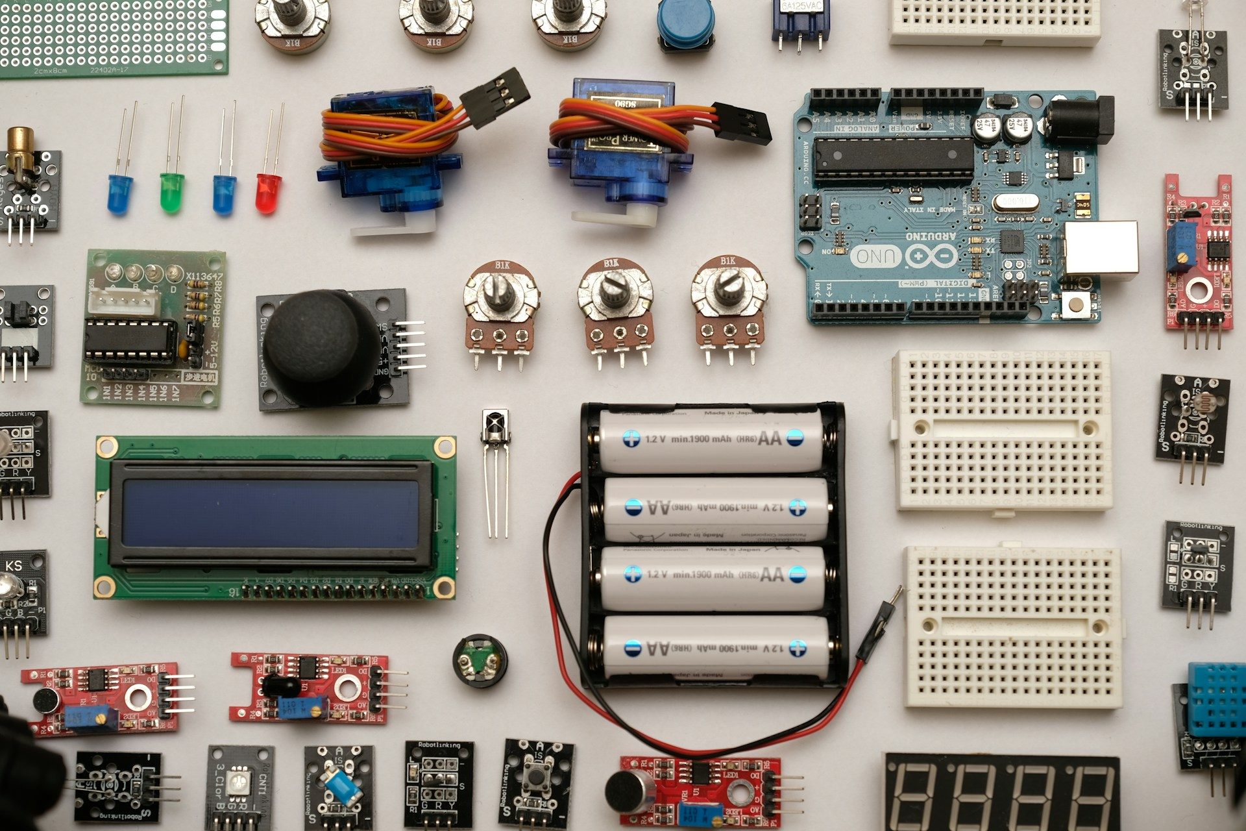
意外
Notes:
https://unsplash.com/photos/flat-lay-photography-of-circuit-board-zP7X_B86xOg

Slide 11
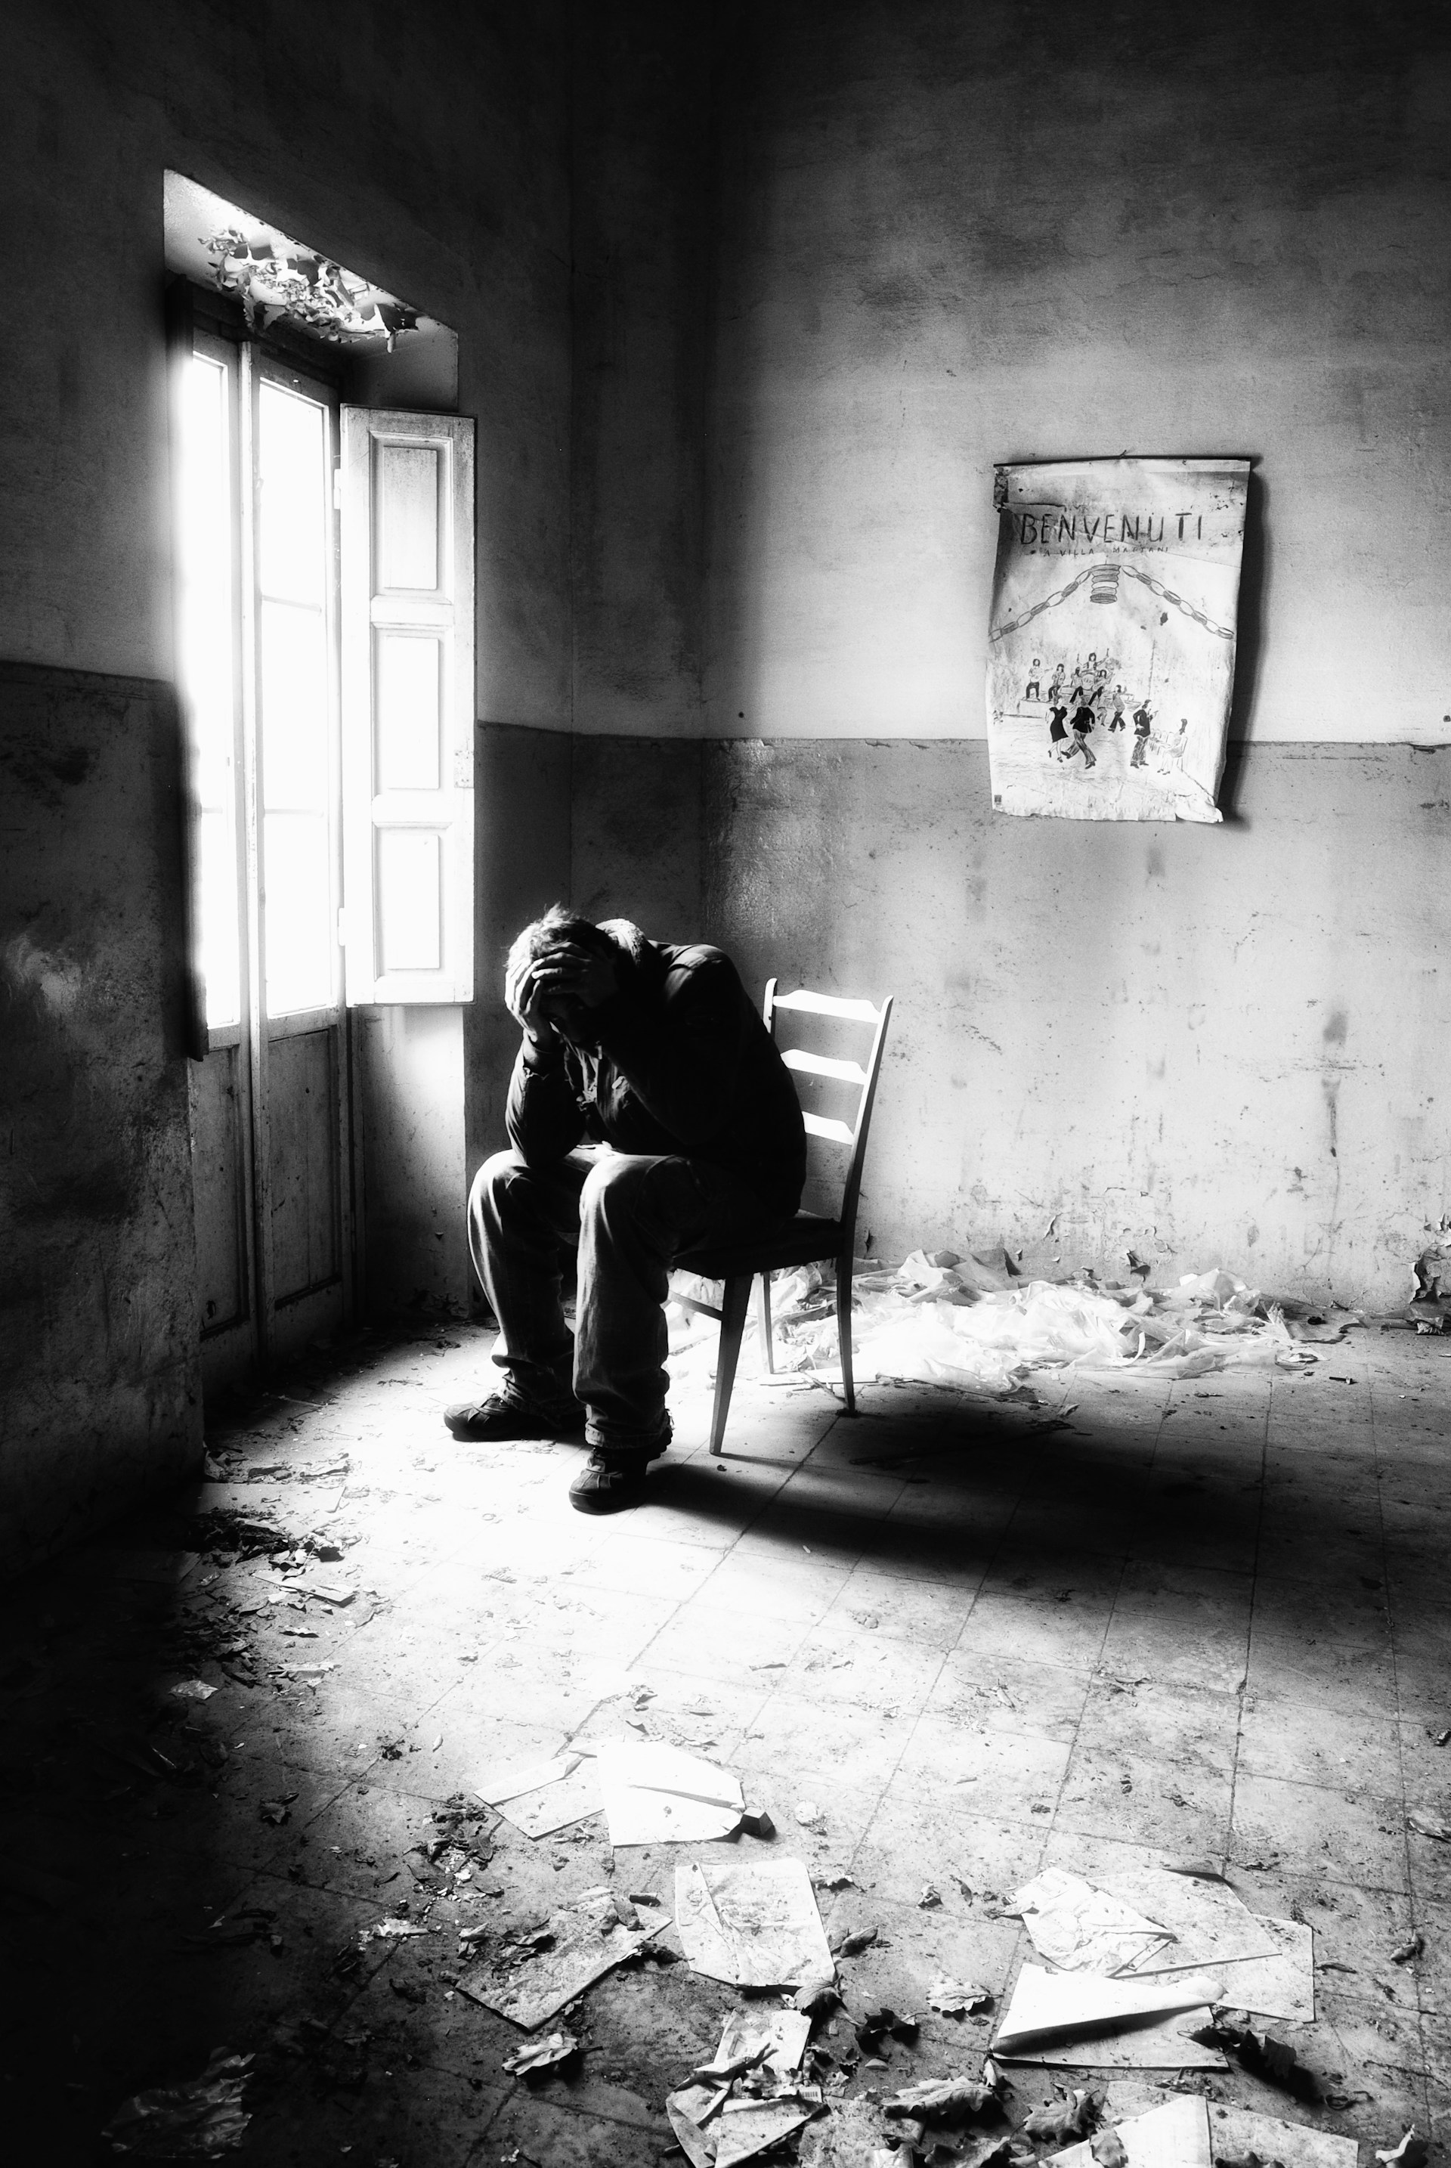
Notes:
https://unsplash.com/photos/a-man-sitting-in-a-chair-in-a-room-0Zg-9QGS0gg

Slide 12

轉彎
Notes:
https://unsplash.com/photos/black-laptop-computer-3Mhgvrk4tjM

Slide 13
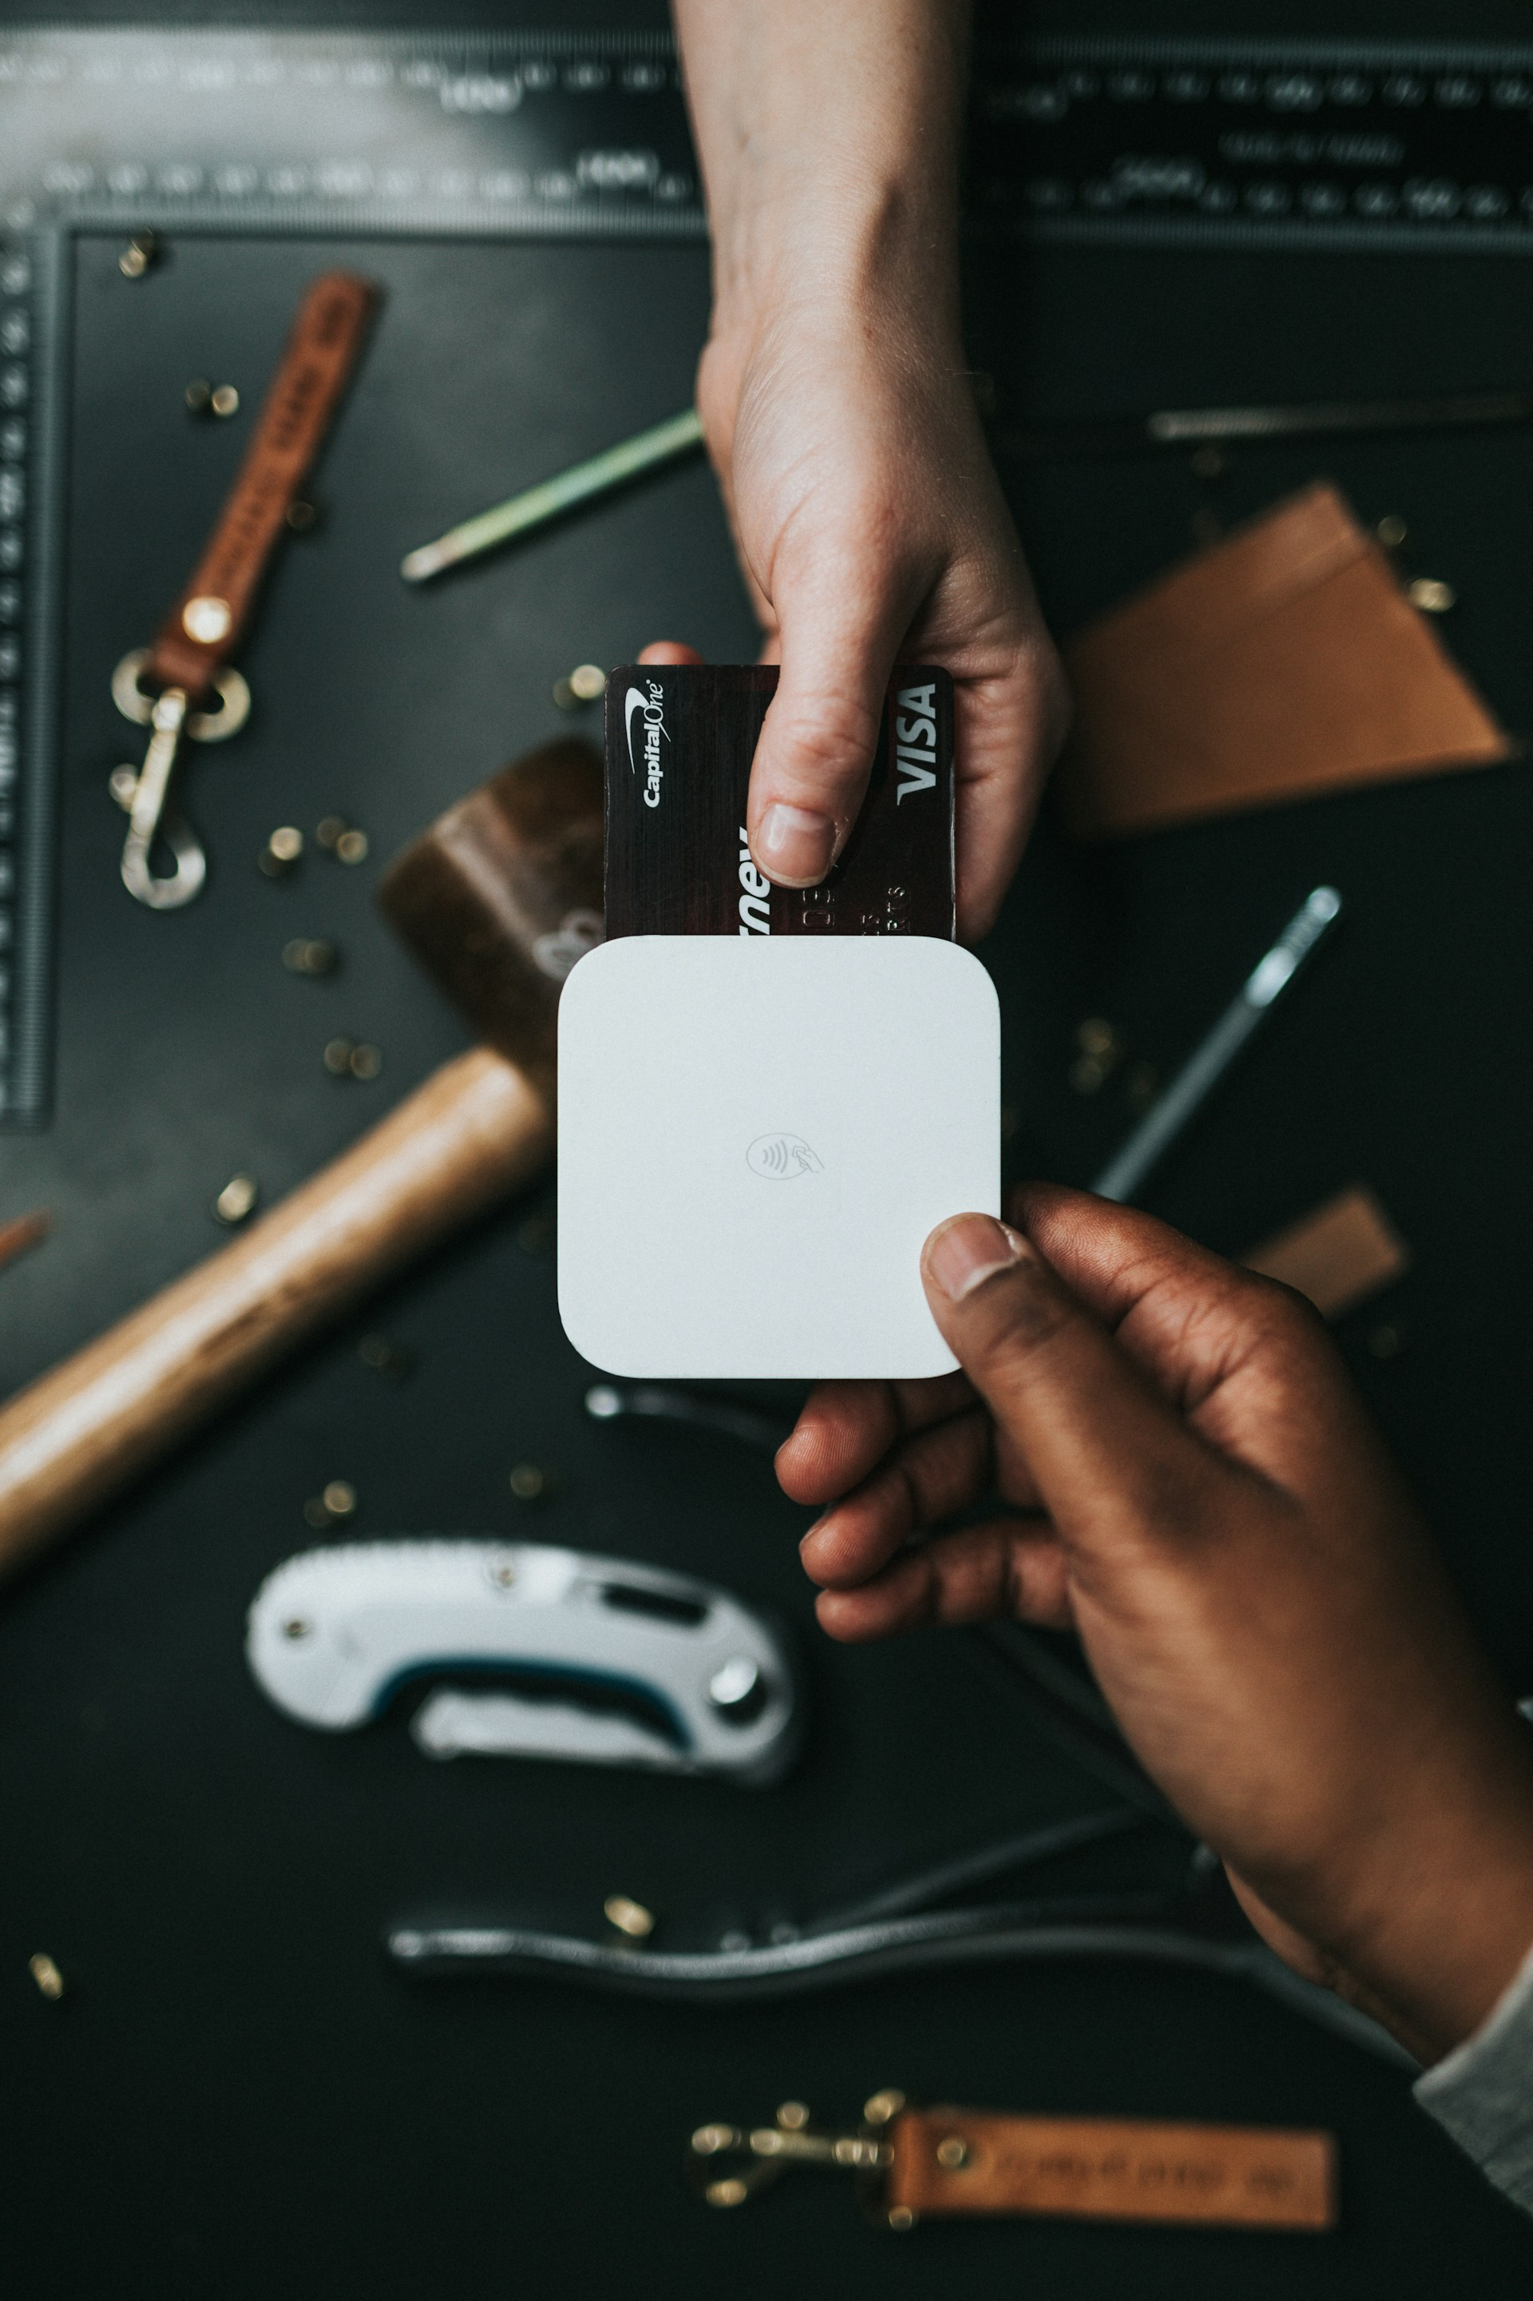
Notes:
https://unsplash.com/photos/person-holding-visa-card-and-white-device-lvWw_G8tKsk

Slide 14
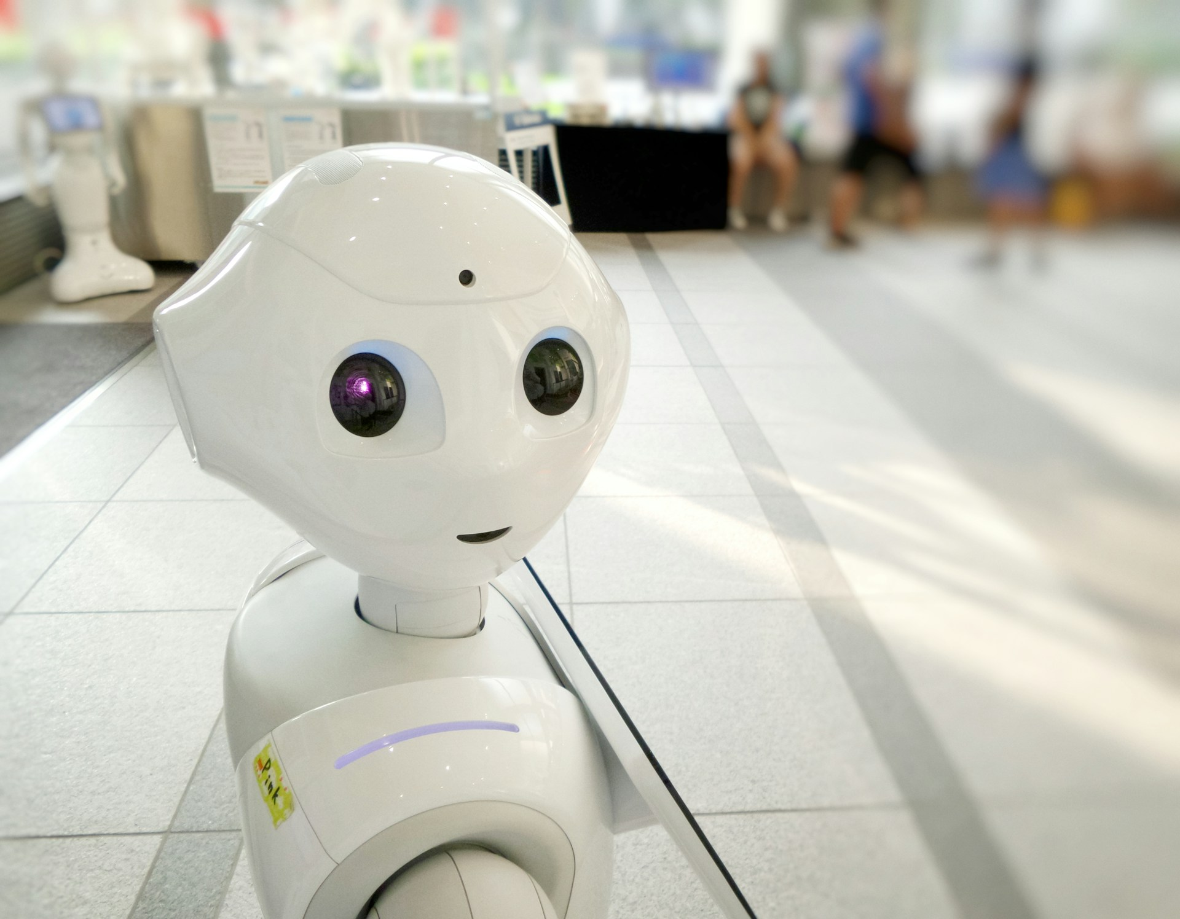
結局
Notes:
https://unsplash.com/photos/white-robot-action-toy-zbLW0FG8XU8

Slide 15

Notes:
https://unsplash.com/photos/people-raising-wine-glass-in-selective-focus-photography-ULHxWq8reao

